Slide 1
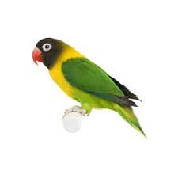
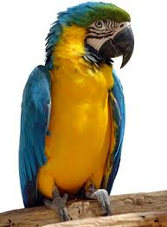
Practical 3- Class, Object | Property, Method
Create a pet class which contains the pet’s name, age, eye colour and country.
Create the a mutator and an accessor function to accept and display the property values.
Create two pet’s objects and assign the appropriate property values for these two objects.
Display the image and information of these pets in a table as shown below.
PET
NAME | AGE | EYE COLOUR | COUNTRY
8

Slide 2
Practical 1 – External JavaScript
Access to the following website:
https://www.w3schools.com/js/js_whereto.asp
Try out the codes in step 1 (JavaScript code) and step 2 (HTML code).
Discuss 4 advantages using the external JavaScript.
Discuss 4 disadvantages using the external JavaScript.

Slide 3
Practical 2 – External JavaScript
Try out the following code.
Rewrite the JavaScript code using an external JavaScipt.
<body>
<p> Create a window and display the name of the new window.</p>
<button onclick=“windFunction()">Click Me</button>
<script>
function windFunction() {
var myWind = window.open("", "Happy Window", "width=300,
height=200");
myWind.document.write("<p>This window's name is: " +
myWind.name + "</p>");
} </script> </body>

Slide 4
Practical 3 – External JavaScript
Try out the following code.
Rewrite the JavaScript code using an external JavaScript.
<body>
<a href=“#” onclick=“windFunction()”> Link text</a>
<script>
function windFunction() {
window.open("popup.html", "PopUp",
"toolbar=no,width=500,height=300");
}
</script> </body>

Slide 5
Practical 4 – External JavaScript
Write the JavaScript code using an external JavaScript (browserObject.js).
function naviVers() {
var ver = "Version info: " + navigator.appVersion;
document.getElementById("demo").innerHTML = ver;
}
function naviName() {
var nm = "Browser Name: " + navigator.appName;
document.getElementById("demo1").innerHTML = nm;
}
Create a HTML file to display the name and version of your browser by calling the two functions created in browserObject.js.

